Slide 1
BUSINESS INTELLIGENCE 381 G. Mudare

Slide 2
Advanced Analytics with Power BI and R
Part 1: R Basics

Slide 3
R Data Structures
R language has predefined data structures that each serves specific purpose.
R, uses data structures such as
Vector - an ordered collection of values of the same atomic data type
List - an ordered collection of objects known as its components with differing modes or types.
Data Frame - rectangular array of data, similar to a matrix, but may have columns of differing types.
Factor - codings for categorical variables, that take on one of a finite number of categories e.g. {"high", "medium", and "low"} .
Array - a vector with one or more dimensions. (A one-dimensional array can be considered a vector, and an array with two dimensions can be considered a matrix.)
Matrix - rectangular array of values of one type arranged in rows and columns

Slide 4
Vector – C()
Vector stores the order set of values.
Each value belongs to a data type.
Vector can hold data types like
Integer (numbers without decimals),
Double (numbers with decimals),
Character (text data),
Logical (TRUE or FALSE values).

Slide 5
Vector – C()
We use Function c() to define a vector.
subject_name <- c("John Doe", "Jane Doe", "Steve Graves")
temperature <- c(98.1, 98.6, 101.4)
flu_status <- c(FALSE, FALSE, TRUE)
To access the second element in body temperature vector use
temperature[2]
There is a possibility to get the range of values in a vector e.g. temperature[2:3]
All elements of an atomic vector must be the same type
Given a vector, you can determine its type with typeof(), e.g:
typeof(flu_status)
Depending on data type, we can use functions such as
mean(temperature)
sort(subject_name)

Slide 6
Vector – C()
We can select specific elements of each vector
There is a possibility to get the range of value in a Vector

Slide 7
Factor – Factor()
A Factor is specific type of vector that stores the categorical or ordinal variables.
Instead of storing the “female” and “male” type in a vector, computer stores 1,2 that takes less space in storage.
To define a factor for storing gender we first should have a vector of gender e.g. c(“Female”, “Male”)
Use command Factor()

Slide 8
Factor – Factor()
When we call gender it shows genders of people that we stored in vector plus a value called “Level”,
Level show the possible values in gender vector.
For instance, if currently we just have BA and Master students
in the future there is a possibility that we could have PhD or Diploma students, we create a factor

Slide 9
Lists-list()
List is similar to vector but is able to have a combination of data types whilst in Vector we just can have one data type e.g.
lst <- list(name="Fred", wife="Mary", no.children=3, child.ages=c(4,7,9))
Components are always numbered and may always be referred to as such.
Components of lists may also be named, and in this case the component may be referred to either by giving the component name as a character string in place of the number in double square brackets e.g.
lst$name is the same as lst[[1]] and is the string "Fred".

Slide 10
Data frames- data.frame()
Data frame is a data format that we mostly deal with in R.
A data frame is similar to a table in databases, with each row being an observation (or record) and each column being a variable (or feature).
A data frame is a list with class "data.frame“ and may be regarded as a matrix with columns possibly of differing modes and attributes.

Slide 11
Data frames- data.frame()
To define a data frame we use data.frame() syntax as below:
pt_data <- data.frame(subject_name, temperature, flu_status, gender, blood, symptoms, stringsAsFactors = FALSE)
R automatically converts every character vector to a factor.
To avoid that we use StringAsfactors as parameter that specify character data type should not be considered as factor.
Example of a data frame:

Slide 12
Data frames- data.frame()
Since a data frame is like a table we can access the cells, rows and columns separately
To fetch a specific column like age we use below code
If we just want to see age and gender of students

Slide 13
Data frames- data.frame()
we can extract all the rows of the first column
We can also extract all columns of data for a specific student

Slide 14
Data Exploration and Visualization in R
Data exploration with R starts with inspecting the dimensionality, structure and data of an R object, followed by basic statistics and various charts like pie charts and histograms.
Function dim() returns the dimensionality of data variables (or columns).
The name of variables are returned by names().
Functions str() and attributes() return the structure and attributes of data.
The first or last rows of data can be retrieved with head() or tail(), which by default return the first or last 6 rows.
Alternatively, we can get a certain number of rows by setting the second parameter to both functions.

Slide 15
Data Exploration and Visualization
R contains some sample datasets,
For example, the iris dataset has been used for classification in many research publications.
It consists of 50 samples from each of three classes of iris flowers.
The datasets package needs to be loaded to access the data.
library(datasets)
data(iris)
dim(iris)
names(iris)
str(iris)
attributes(iris)
head(iris)
summary(iris)

Slide 16
Data Exploration and Visualization
We can also check the variance of Sepal.Length with var(),
var(iris$Sepal.Length)
Also check its distribution with histogram and density using functions hist() and density().
hist(iris$Sepal.Length)
plot(density(iris$Sepal.Length))
The frequency of a factor variable can be calculated with function table(), and then plotted as a pie chart with pie() or a bar chart with barplot().
table(iris$Species)
pie(table(iris$Species))
barplot(table(iris$Species))
cor(iris$Sepal.Length, iris$Petal.Length)

Slide 17
Advanced Analytics with Power BI and R
Create Power BI visuals using R

Slide 18
Having Charts by writing R code
Power BI enables users to embed R graphs in Power BI.
There are some R visuals that would be very nice to have them in Power BI.
The R language is widely used among statisticians and data miners for developing statistical software and data analysis of polls, surveys of data miners, and studies of scholarly literature databases
R’s popularity has increased substantially in recent years.
R has more than 1000 packages to perform different tasks.
“ggplot2” is the main package for drawing visuals which contains various functions to draw different type of charts.

Slide 19
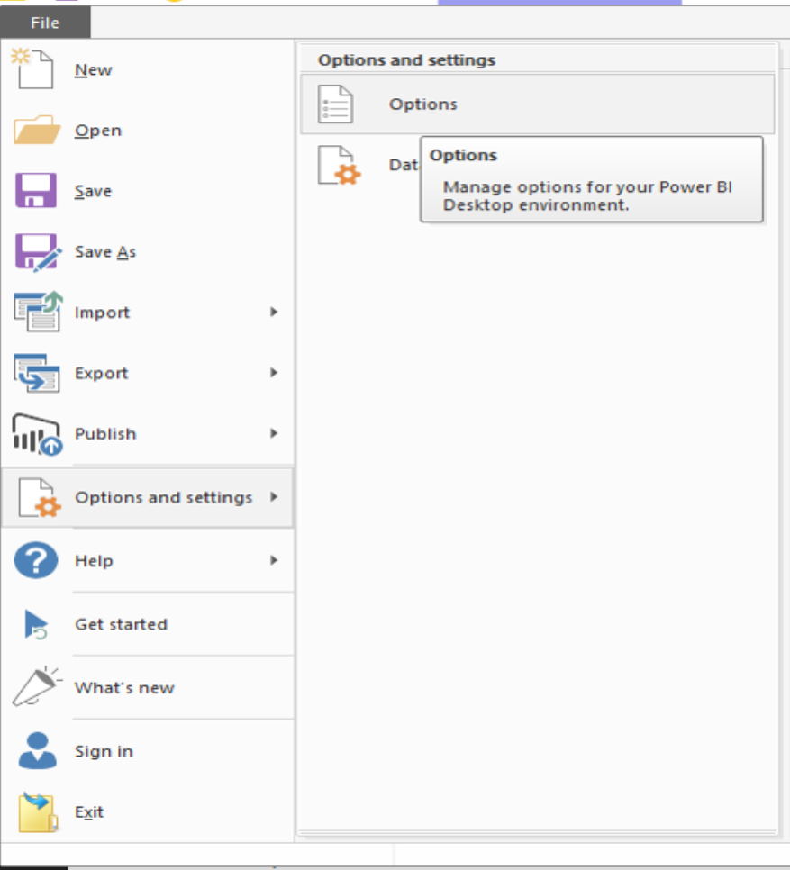
Getting Started
You must already have one version of R on your machine.
In Power BI Desktop click on the File menu, then click on the “Options and Settings”
Then on ” Options” under the “Global” option click on “R Scripting”.

Slide 20
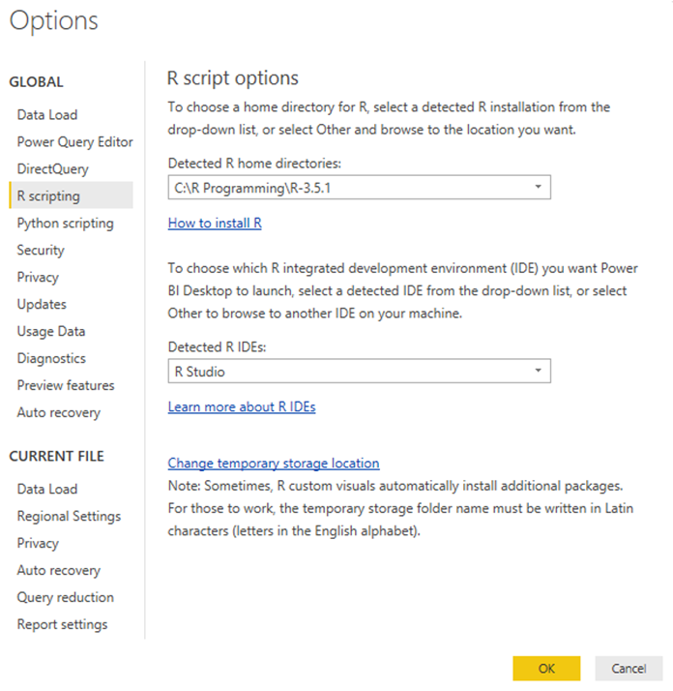
Getting Started
Verify that your local R installation is specified in Detected R home directories and that it properly reflects the local R installation you want Power BI Desktop to use.
You are ready to begin creating R visuals.

Slide 21
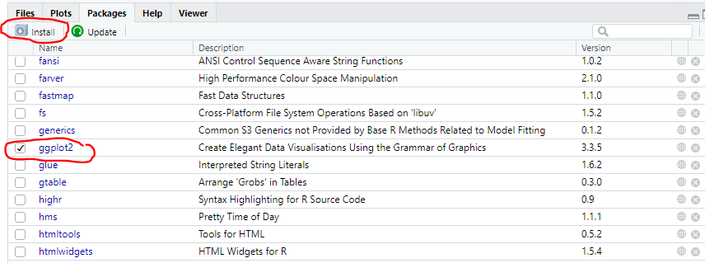
INSTALL REQUIRED PACKAGES
Open RStudio
If it is the first time working in R, it is a requirement that you install the packages you need.
In this instance use “ggplot2″ in Power BI for your various charts:
Check if “ggplot2″ is already installed.
If it is not you would use:
install.packages("ggplot2")
(or click Install on Packages pane)
ggplot2 will install some other packages itself.

Slide 22
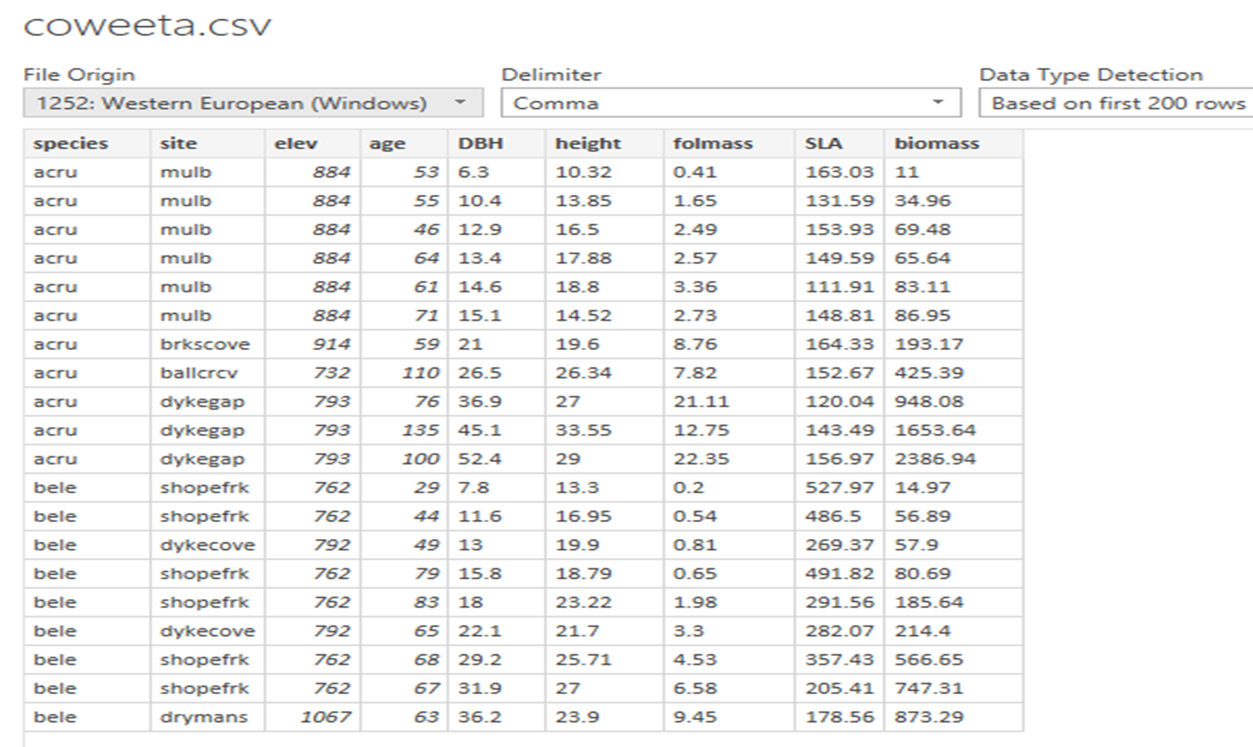
Load Dataset in Power BI
In Power BI Desktop, load the “coweeta.csv” file.
After inspecting the data, click Transform.
Check the data types and if necessary perform some data transformations.
Click Close & Apply.

Slide 23
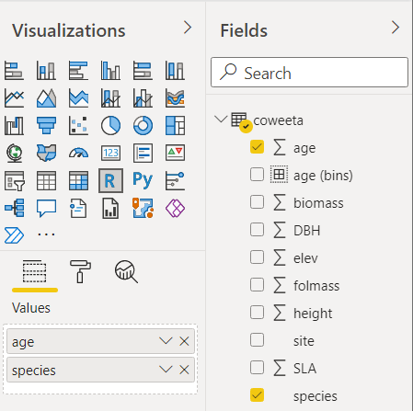
Create R visuals in Power BI Desktop
In Power BI Desktop, select age species and in the Fields pane.
Change the default aggregation for age from sum to average.
A column chart will be created by default.
Select the R Visual icon in the Visualization pane to change to an R visual.
In the Enable script visuals window that appears, click on the canvas and Enable scripts.

Slide 24
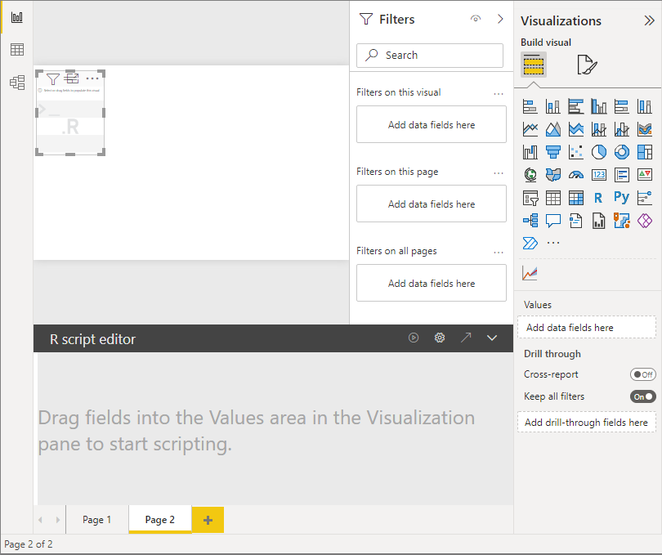
Create R visuals in Power BI Desktop
When you add an R visual to a report, Power BI Desktop makes the following changes:
A placeholder R visual image appears on the report canvas.
The R script editor appears along the bottom of the center pane.
In the Values section of the Visualization pane, drag fields from the Fields pane that you want to consume in your R script, just as you would with any other visual.
As you select fields, the R script editor generates supporting R script binding code for those fields in the gray section along the top of the editor pane.
If you remove a field, the R script editor automatically removes the supporting code for that field.

Slide 25
mpg
library(ggplot2)
t<-ggplot(dataset, aes(x=cty, y=hwy,size=cyl,fill="Red")) + geom_point(pch=23)+scale_size_continuous(range=c(1,10))
t
add other layers to this chart. add year and car drive option to the chart.
first choose year and drv
use function “facet_grid”
t<-ggplot(dataset, aes(x=cty, y=hwy,colour = factor(cyl))) + geom_point(size=4) t<-t + facet_grid(year ~ drv)

Slide 26
Create R visuals in Power BI Desktop
library(ggplot2)
#t<-ggplot(dataset, aes(x=cty, y=hwy,size=cyl,fill="Red")) + geom_point(pch=23)#+scale_size_continuous(range=c(1,10))
#t<-ggplot(dataset, aes(x=cty, y=hwy,colour = factor(cyl))) + geom_point(size=4)
t<-ggplot(dataset, aes(x=cty, y=hwy,colour = factor(cyl))) + geom_point(size=4)
t<-t + facet_grid(year ~ drv)
T
add a slicer to filter “car brands”,

Slide 27
Try using the following
t<-ggplot(dataset, aes(x=cty, y=hwy,color=cyl)) + geom_point(size=5) t<-t + facet_wrap(year~ drv)
t

Slide 28
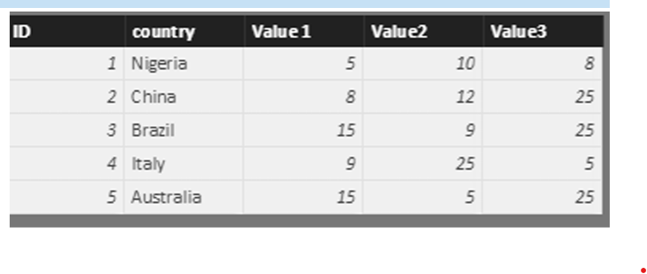
show some sub plots in a map chart.

Slide 29
show some sub plots in a map chart.
# dataset <- data.frame(Country, Value1, Value2, Value3)
# dataset <- unique(dataset)
library(rworldmap)
library(sp)
ddf =dataset
sPDF <- joinCountryData2Map(ddf, joinCode = "NAME", nameJoinColumn = "country", verbose = TRUE)
plot(getMap())

Slide 30
show some sub plots in a map chart.
merg the data to get the location information from “sPDF” into “ddf”
df <- merge(x=ddf, y=sPDF@data[sPDF@data$ADMIN, c("ADMIN", "LON", "LAT")], by.x="country", by.y="ADMIN", all.x=TRUE) .
draw a simple bar chart that show the value1, Value2, and Value 3 for each country.
for (i in 1:nrow(df)) subplot(barplot(height=as.numeric(as.character(unlist(df[i, 2:4], use.names=F) ) ), axes=F, col=rainbow(3), ylim=range(df[,2:4]) ), x=df[i, 'LON'], y=df[i, 'LAT'], size=c(.6, .6) )
a legend on the side of the map
legend("topright", legend=names(df[, 2:4]), fill=rainbow(3))
subplot(pie(as.numeric(as.character(unlist(df[i, 2:4], use.names=F))),

Slide 31
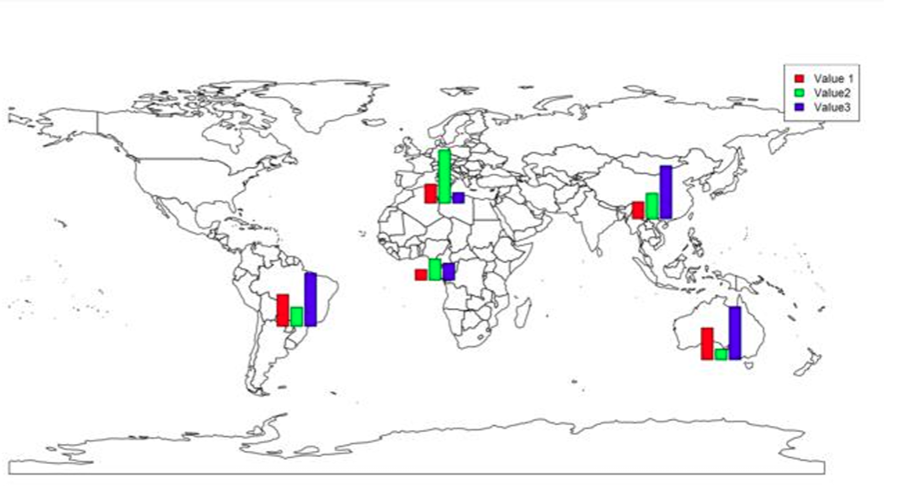
show some sub plots in a map chart

Slide 32
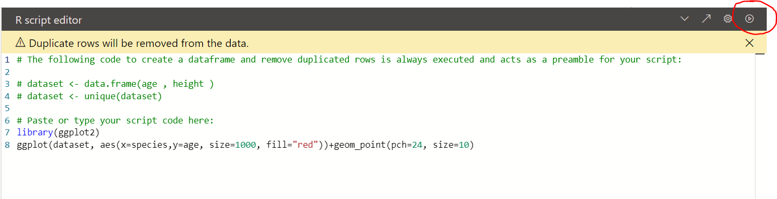
R script editor
“#” is a symbol for comments in R language which you can see in R scripts Editor.
Power BI automatically puts the selected fields in a variable name “dataset” so all fields (species, and age) will store in a dataset variable by “<-” sign.
Also it automatically removes the duplicated rows.

Slide 33
Charts by writing R code
Put R code for drawing a two dimensional graph in power BI.
You have to call the packages first using “library”
library(ggplot2)
Whatever library you use in Power BI, call it by library function first.
Some cases will require you to install some other packages to make them work
To draw a chart first use “ggplot” function to draw a two dimensional chart.
The first argument is “dataset” which holds your two fields.
Have another function inside the ggplot, named “aes” that identifies which field should be in x axis or in y axis
You can add another layer in aes function as “Size” for the size of dots in your chart.
t<-ggplot(dataset, aes(x=species, y=age,size=10))
t

Slide 34
Charts by writing R code
The geom_point enables you to draw a scatter charts
This function has such value as pch=21 which depicts the shape of the dot in chart,
pch= 20 gives a filled circle and 23 gives a diamond shape.
You can test other pchs on your own.
In this case put 21 and run your script

Slide 35
Charts by writing R code
You can add another code inside of ” aes” function name “fill=Red” to show triangles filled in red colour
t<-ggplot(dataset, aes(x=species, y=age,size=10,fill="Red")) + geom_point(pch=24)
t
Make sue that your x and y matches with the selected fields in Fields pane.
You can also change the style of axis labels by using + theme e.g.
t <- ggplot(dataset, aes(x=species, y=age,size=800,fill="Red")) + geom_point(pch=24, size=10) + theme(axis.text.x = element_text(color="#0000FF",size=20),axis.text.y = element_text(color="#0000FF",size=20))
t
It is also possible to show 5 different variables in just one chart, by using facet command in R. This helps us to have more dimensions in our charts

Slide 36
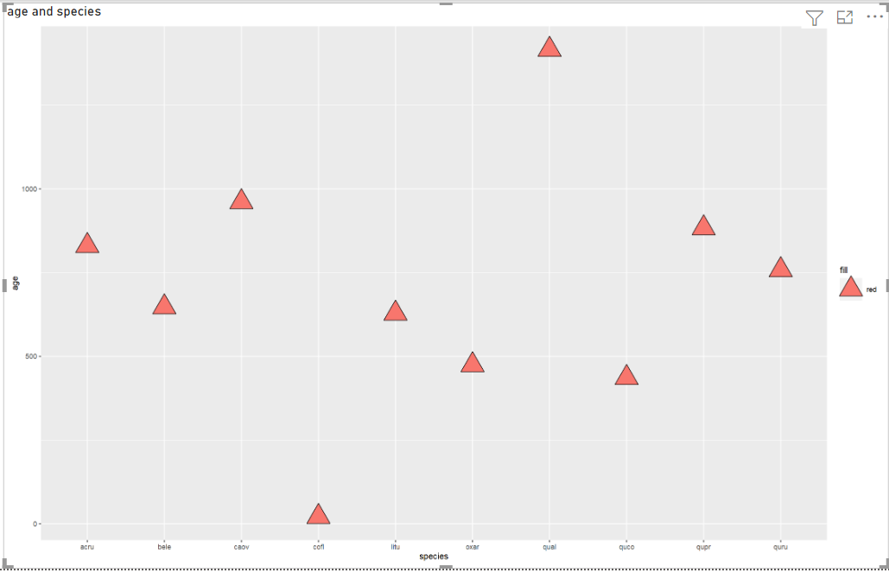
Charts by writing R code

Slide 37
Some Common limitations
R visuals in Power BI Desktop have the following limitations:
Data sizes: Data used by an R visual for plotting is limited to 150,000 rows. If more than 150,000 rows are selected, only the top 150,000 rows are used and a message is displayed on the image.
Calculation times: If an R visual calculation exceeds five minutes, it causes a time-out error.
Relationships: As with other Power BI Desktop visuals, if data fields from different tables with no defined relationship between them are selected, an error occurs.
Refreshes: R visuals are refreshed upon data updates, filtering, and highlighting. However, the image itself isn't interactive and can't be the source of cross-filtering.
Highlights: R visuals respond if you highlight other visuals, but you can't select elements in the R visual to cross filter other elements.
Display devices: Only plots that are plotted to the R default display device are displayed correctly on the canvas. Avoid explicitly using a different R display device.
Column renaming: R visuals do not support renaming input columns. Columns will be referred to by their original name during script execution.

Slide 38
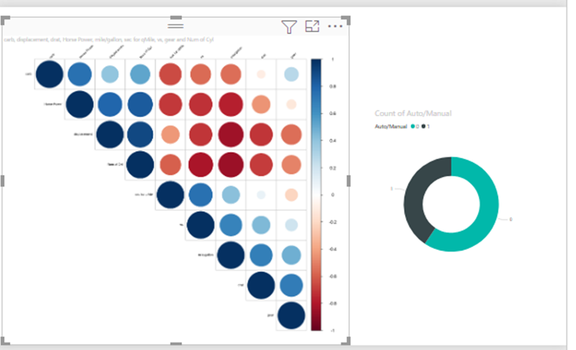
PRACTICE
Use the “allometry.csv” to visualize the relationship between diameter and height using R visual in Power BI.
Make use of corrplot in package corrplot.
(The visual on the right is just for illustration purposes and may vary from your final visual)

